Slide 1


Week 14
ANALYSIS OF VARIANCE (ANOVA)
IT 221 - Quantitative Methods
Group 4 Presentation

Slide 2

WHAT IS ANOVA?
ANOVA (Analysis of Variance) is a statistical method used to compare the means of three or more groups to determine if there is a significant difference among them.
TWO MAIN TYPES OF ANOVA
1
One-way ANOVA
Two-way ANOVA
01
2

Slide 3

ONE-WAY ANOVA
One-Way ANOVA (Analysis of Variance) is a statistical method used to determine whether there are significant differences between the means of three or more groups based on one independent variable (factor) and one dependent variable.
EXAMPLE
Comparing the test scores of students from 3 different teaching methods.
02

Slide 4

ASSUMPTIONS OF ONE-WAY ANOVA
Before applying ANOVA, these conditions must be met:
Independence of observations
Each group must be independent from the others.
Normality
Data in each group should be approximately normally distributed.
Homogeneity of variance
03
Variances of all groups should be equal.

Slide 5
PROCEDURE
1
State hypotheses
Define the null and alternative hypotheses.
2
Set significance level
Usually α = 0.0 (5% margin of error).
3
Compute ANOVA table (F-value)
Compare variation between groups.
4
Compare p-value with α
Check if p-value is less than or greater than α.
5
Make a decision
Reject or fail to reject null hypothesis.
04

Slide 6
EXAMPLE
Null Hypothesis (H₀)
There is no significant difference in the mean test scores among the three teaching methods.
Teaching Methods
Mean
Traditional method
75
Online method
78
Blended method
85
05
Significance level (α) = 0.05
p-value = 0.02

Slide 7
INTERPRETATION
Since p-value (0.02) < α (0.05), we reject the null hypothesis (H₀). Therefor, there is a significant difference in the mean test scores among the three teaching methods. This implies that at least one method performs differently compared to the others.
06

Slide 8
TWO-WAY ANOVA
Two-Way ANOVA is used when there are two independent variables (factors) affecting a dependent variable.
EXAMPLE
Studying how teaching method and gender affect student performance.
07

Slide 9

KEY CONCEPTS
HYPOTHESES
Main Effects
For Two-Way ANOVA, there are three sets of hypotheses:
Effect of each independent variable separately.
For Factor A
Interaction Effects
For Factor B
Whether the two variables combined have a unique effect.
For Interaction (A x B
08

Slide 10
PROCEDURE
1
Identify the two factors
2
State hypotheses for each factor and interaction
3
Compute F-values for:
Factor A
Factor B
Interaction (A x B)
4
Compare p-value with α
09
5
Interpret results

Slide 11
EXAMPLE
Null Hypothesis (H₀)
There is no significant effect of teaching method and study time, and no interaction between them, on students’ test scores.
Teaching Methods
Short Study
Time
Short Study
Time
Traditional
70
80
Online
75
90
Significance level (α): 0.05
Teaching Method: p = 0.04
10
Study Time: p = 0.001
Interaction (Method × Time): p = 0.03

Slide 12
INTERPRETATION
Since the p-values for teaching method (0.04), study time (0.001), and their interaction (0.03) are all less than 0.05, we reject the null hypothesis (H₀). This means that teaching method, study time, and their combined interaction all have a significant effect on students’ test scores.
11

Slide 13
APPLICATION AND INTERPRETATION OF ANOVA
UNDERSTANDING THE F-VALUE
The F-value measures the ratio of:
Variation between groups
Variation within groups
Higher F-value = more likely there is a significant difference
12

Slide 14
APPLICATION AND INTERPRETATION OF ANOVA
UNDERSTANDING THE P-VALUE
The p-value tells us if the result is statistically significant.
p-value
Decision
≤ 0.05
Significant
> 0.05
Not Significant
13

Slide 15
APPLICATION AND INTERPRETATION OF ANOVA
POST-HOC TESTS
If ANOVA shows a significant result, we perform post-hoc tests to find which groups differ.
Common Post-hoc Tests
Tukey’s HSD
Bonferroni
14
Scheffé

Slide 16
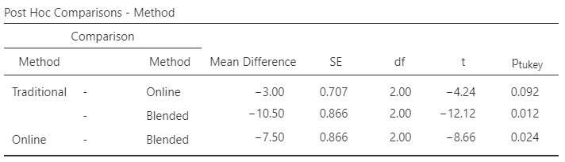
POST-HOC TEST
TUKEY’S HSD
15

Slide 17
INTERPRETATION
The post hoc test (Tukey) shows that there is no significant difference between the Traditional and Online teaching methods (p = 0.092 > 0.05), meaning they have similar effects on student performance. However, the Blended method is significantly different from both Traditional (p = 0.012 < 0.05) and Online (p = 0.024 < 0.05), with higher mean scores in both comparisons. This indicates that the Blended teaching method leads to significantly better student performance compared to the other two methods.
16

Slide 18
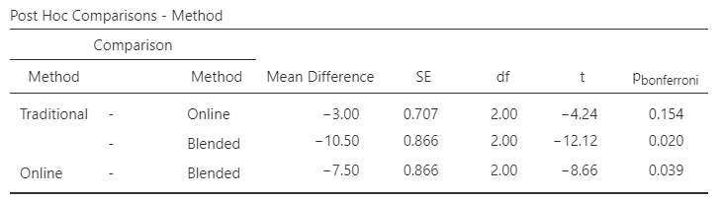
POST-HOC TEST
BONFERRONI
17

Slide 19
INTERPRETATION
The Bonferroni post hoc test shows that there is no significant difference between the Traditional and Online methods (p = 0.154). However, the Blended method is significantly different from both Traditional (p = 0.020) and Online (p = 0.039), with higher mean scores. This indicates that the Blended teaching method produces better student performance compared to the other two methods.
18

Slide 20
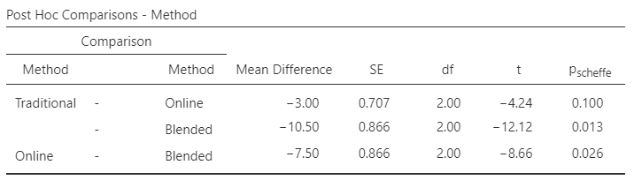
POST-HOC TEST
SCHEFFÉ
19

Slide 21
INTERPRETATION
The Scheffé post hoc test shows that there is no significant difference between the Traditional and Online methods (p = 0.100). However, the Blended method is significantly different from both Traditional (p = 0.013) and Online (p = 0.026), with higher mean scores. This indicates that the Blended teaching method leads to significantly better student performance compared to the other two methods.
20

Slide 22
SUMMARY
One-Way ANOVA → compares 3 or more groups using one factor
Two-Way ANOVA → compares groups using two factors and interaction
F-value → measures variation
p-value → determines significance
Post-hoc tests → identify specific group differences
21

Slide 23
Week 15
MEASURES OF ASSOCIATION AND CHI-SQUARE TEST
IT 221 - Quantitative Methods
Group 4 Presentation

Slide 24

MEASURES OF ASSOCIATION
Measures of association are statistical tools used to determine the strength and direction of a relationship between two or more variables.
THIS INCLUDES
1
Pearson’s Correlation
2
Spearman’s Rank-Order Correlation
01

Slide 25
PEARSON’S CORRELATION
Pearson’s Correlation measures the strength and direction of a linear relationship between two continuous variables.
02

Slide 26
KEY FEATURES
Symbol: r
Range: -1 to +1
Value of r
Interpretation
+1
Perfect positive relationship
0
No relationship
-1
Perfect negative relationship
03

Slide 27
ASSUMPTIONS
• Linear relationship
• No extreme outliers
• Continuous data
• Normal distribution (approximate)
INTERPRETATION
Positive correlation → as one variable increases, the other increases
Negative correlation → as one increases, the other decreases
04

Slide 28
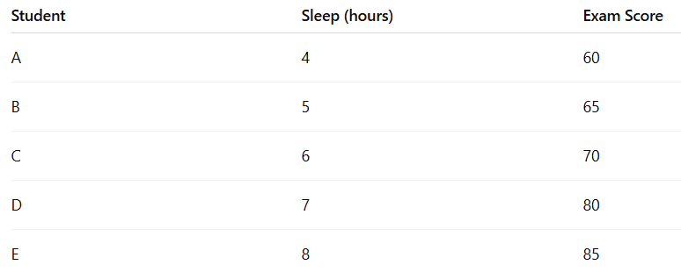
EXAMPLE
Null Hypothesis (H₀) : There is no significant linear relationship between hours of sleep and exam scores.
Significance level (α): 0.05
Pearson’s r = 0.96
p = 0.01
05

Slide 29
INTERPRETATION
The Pearson correlation shows a very strong positive linear relationship (r = 0.96) between hours of sleep and exam scores. This indicates that students who sleep more tend to achieve higher exam scores. Since the p-value (0.01) is less than 0.05, the relationship is statistically significant, meaning the association is unlikely due to chance.
06

Slide 30
SPEARMAN’S RANK-ORDER CORRELATION
Spearman’s Correlation measures the strength and direction of a monotonic relationship using ranked data.
07

Slide 31
KEY FEATURES
Symbol: ρ (rho)
Range: -1 to +1
WHEN TO USE
Data has outliers
Relationship is not linear
Data is in ranks (e.g., 1st, 2nd, 3rd)
08

Slide 32
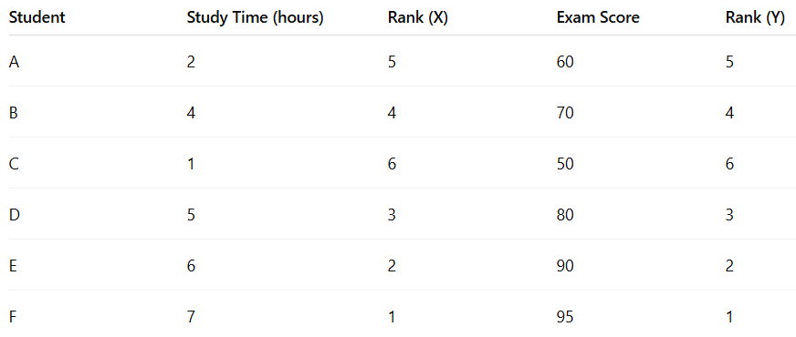
EXAMPLE
Null Hypothesis (H₀) : There is no significant relationship between students’ study time and their exam scores.
Significance level (α): 0.05
Spearman’s rho (ρ) = 0.97
p = 0.002
09

Slide 33
INTERPRETATION
The Spearman’s rank correlation indicates a very strong positive relationship (ρ = 0.97) between study time and exam scores. This suggests that students who spend more time studying generally achieve higher exam scores. The result is statistically significant (p < 0.05), showing that this relationship is unlikely to be caused by random variation in the data.
10

Slide 34
PEARSON VS SPEARMAN
Feature
Pearson
Spearman
Ranked or
Ordinal
Data Type
Continuous
Relationship
Linear
Monotonic
Sensitivity to Outliers
High
Low
11

Slide 35
CHI-SQUARE TEST
The Chi-Square (χ²) test is used to determine if there is a significant association between two categorical variables.
12

Slide 36
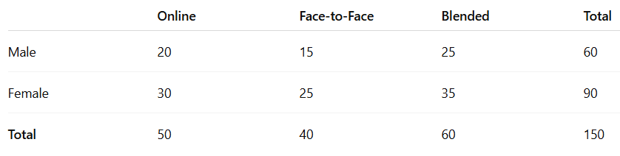
EXAMPLE
Null Hypothesis (H₀) : There is no significant association between gender and preferred learning method.
Significance level (α): 0.05
Chi-square result: χ² = 1.85
13
p = 0.40

Slide 37
INTERPRETATION
The Chi-square test shows that there is no significant relationship between gender and preferred learning method (χ² = 1.85, p = 0.40 > 0.05). This means that male and female students do not differ in their choice of learning method, and the differences observed in the table are likely due to chance.
14

Slide 38

TYPES OF CHI-SQUARE TEST
Chi-Square Test of Independence
1
Checks if two variables are related
Chi-Square Goodness of Fit
2
Checks if data matches expected distribution
ASSUMPTIONS
• Data is categorical
• Observations are independent
• Expected frequency ≥ 5 (in most cells)
15

Slide 39
EXAMPLE OF CHI-SQUARE TEST
Null Hypothesis (H₀) : There is no significant association between gender and preferred learning method.
Significance level (α): 0.05
Chi-square result: χ² = 1.85
16
p = 0.40

Slide 40
SUMMARY
Pearson's Correlation
Linear relationship (continuous data)
Spearman’s Correlation
Monotonic relationship (ranked/non-normal data)
Chi-Square Test
Relationship between categorical variables
17

Slide 41
Week 16
REGRESSION ANALYSIS
IT 221 - Quantitative Methods
Group 4 Presentation

Slide 42
LINEAR REGRESSION
Linear Regression is a statistical method used to model and analyze the relationship between a dependent variable (Y) and one or more independent variables (X).
TYPES OF LINEAR REGRESSION
1
Simple Linear Regression
Multiple Linear Regression
01
2

Slide 43
SIMPLE LINEAR REGRESSION
Simple Linear Regression is a statistical method used to predict the value of one dependent variable (Y) based on one independent variable (X).
02

Slide 44
Single Linear Regression Key Idea
Shows a linear relationship between X (independent variable) and Y (dependent variable).
Used for prediction and forecasting.
INTERPRETATION
Positive slope: As X increases, Y increases
Negative slope: As X increases, Y decreases
03

Slide 45
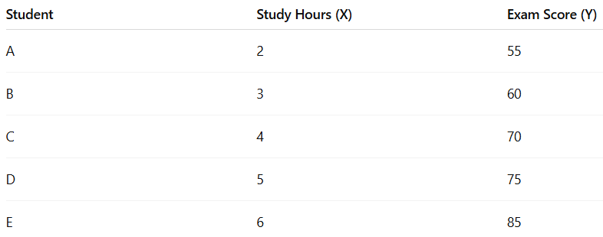
EXAMPLE
Null Hypothesis (H₀) : Study hours do not significantly predict exam scores.
Significance level (α): 0.05
y = 40 + 7.5X
R² = 0.92
p = 0.003
04

Slide 46
INTERPRETATION
The simple linear regression results show that study hours significantly predict exam scores (p < 0.05). The positive coefficient (7.5) indicates that for every additional hour of studying, exam scores increase by about 7.5 points. The high R² value (0.92) suggests that 92% of the variation in exam scores can be explained by study hours, indicating a strong predictive relationship between the two variables.
05

Slide 47
MULTIPLE LINEAR REGRESSION
Multiple Linear Regression predicts a dependent variable using two or more independent variables.
Key Idea
Examines the combined effect of multiple variables
Helps identify which variables are most important
06

Slide 48
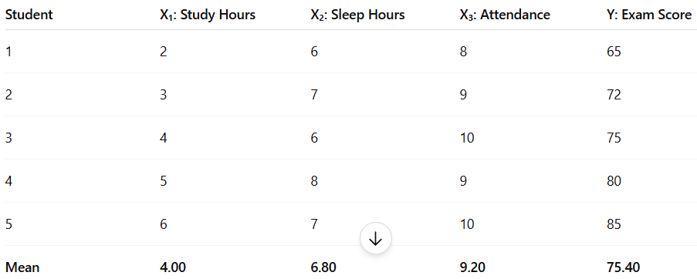
EXAMPLE
Null Hypothesis (H₀) : Predictors such as study hours, sleep hours, and class attendance does not significantly affect exam scores.
Significance level (α): 0.05
R² = 0.989
p = 0.11
07

Slide 49
INTERPRETATION
The multiple linear regression results show that study hours, sleep hours, and class attendance (p ≈ 0.11) are not statistically significant at the 0.05 level of significance. However, the high R² value (0.989) means that about 98.9% of the variation in exam scores is explained by the three predictors, indicating a strong fit to the data but not enough evidence to confirm the relationship for a larger population.
08

Slide 50
SLR VS MLR
Feature
SLR
MLR
No. of Independent Variables
1
2 or more
Complexity
Simple
More complex
Real-world modeling
Application
Basic prediction
09

Slide 51
APPLICATION AND INTERPRETATION
KEY REGRESSION OUTPUTS
A. COEFFICIENTS (B₀, B₁, B₂, …)
EXAMPLE:
Show the effect of house size (X) on house pice (Y).
b₁ = 10 → House Price (Y) increases by 10 units for every 1-unit increase in House Size (X).
10

Slide 52
APPLICATION AND INTERPRETATION
KEY REGRESSION OUTPUTS
B. R² (COEFFICIENT OF DETERMINATION)
Shows how much variation in Y is explained by X
Range: 0 to 1
R² Value
Interpretation
0
No explanation
0.5
Moderate explanation
1
Strong explanation
11

Slide 53
APPLICATION AND INTERPRETATION
KEY REGRESSION OUTPUTS
C. P-VALUE
Tests if the variable is statistically significant
p-value
Decision
≤ 0.05
Significant
> 0.05
Not Significant
12

Slide 54
APPLICATION AND INTERPRETATION
KEY REGRESSION OUTPUTS
D. CONFIDENCE INTERVAL (CI)
Range where the true value of the coefficient is likely found.
If CI does not include 0 → significant.
13

Slide 55

SUMMARY
Simple Linear Regression → one predictor
Multiple Linear Regression → multiple predictors
Coefficients → effect of variables
R² → model strength
p-value → significance
Confidence Interval → reliability of estimates
14

Slide 56
THANK YOU

